Slide 1
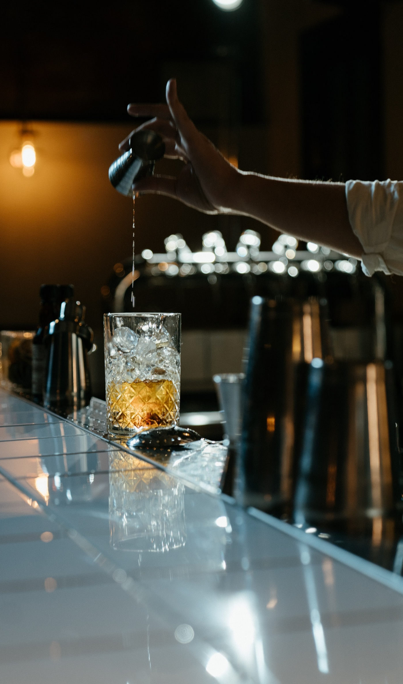
The art of the cocktail
A brief glimpse into history
Photo by cottonbro from Pexels

Slide 2
What is your favorite Cocktail? Please enter your answer in the chat

Slide 3
Four Points of Balance
Strong
Bitter/Sour
Sweet
Weak

Slide 4
Mixed Drinks
Sour
Collins
Punch
Spirit Driven
Highball
Cocktail Families

Slide 5
How do you define “cocktail” What is it?

Slide 6
1806 The Balance and Columbian Repository
“A stimulating liquor composed of spirits of any kind, sugar, water, and bitters.”

Slide 7
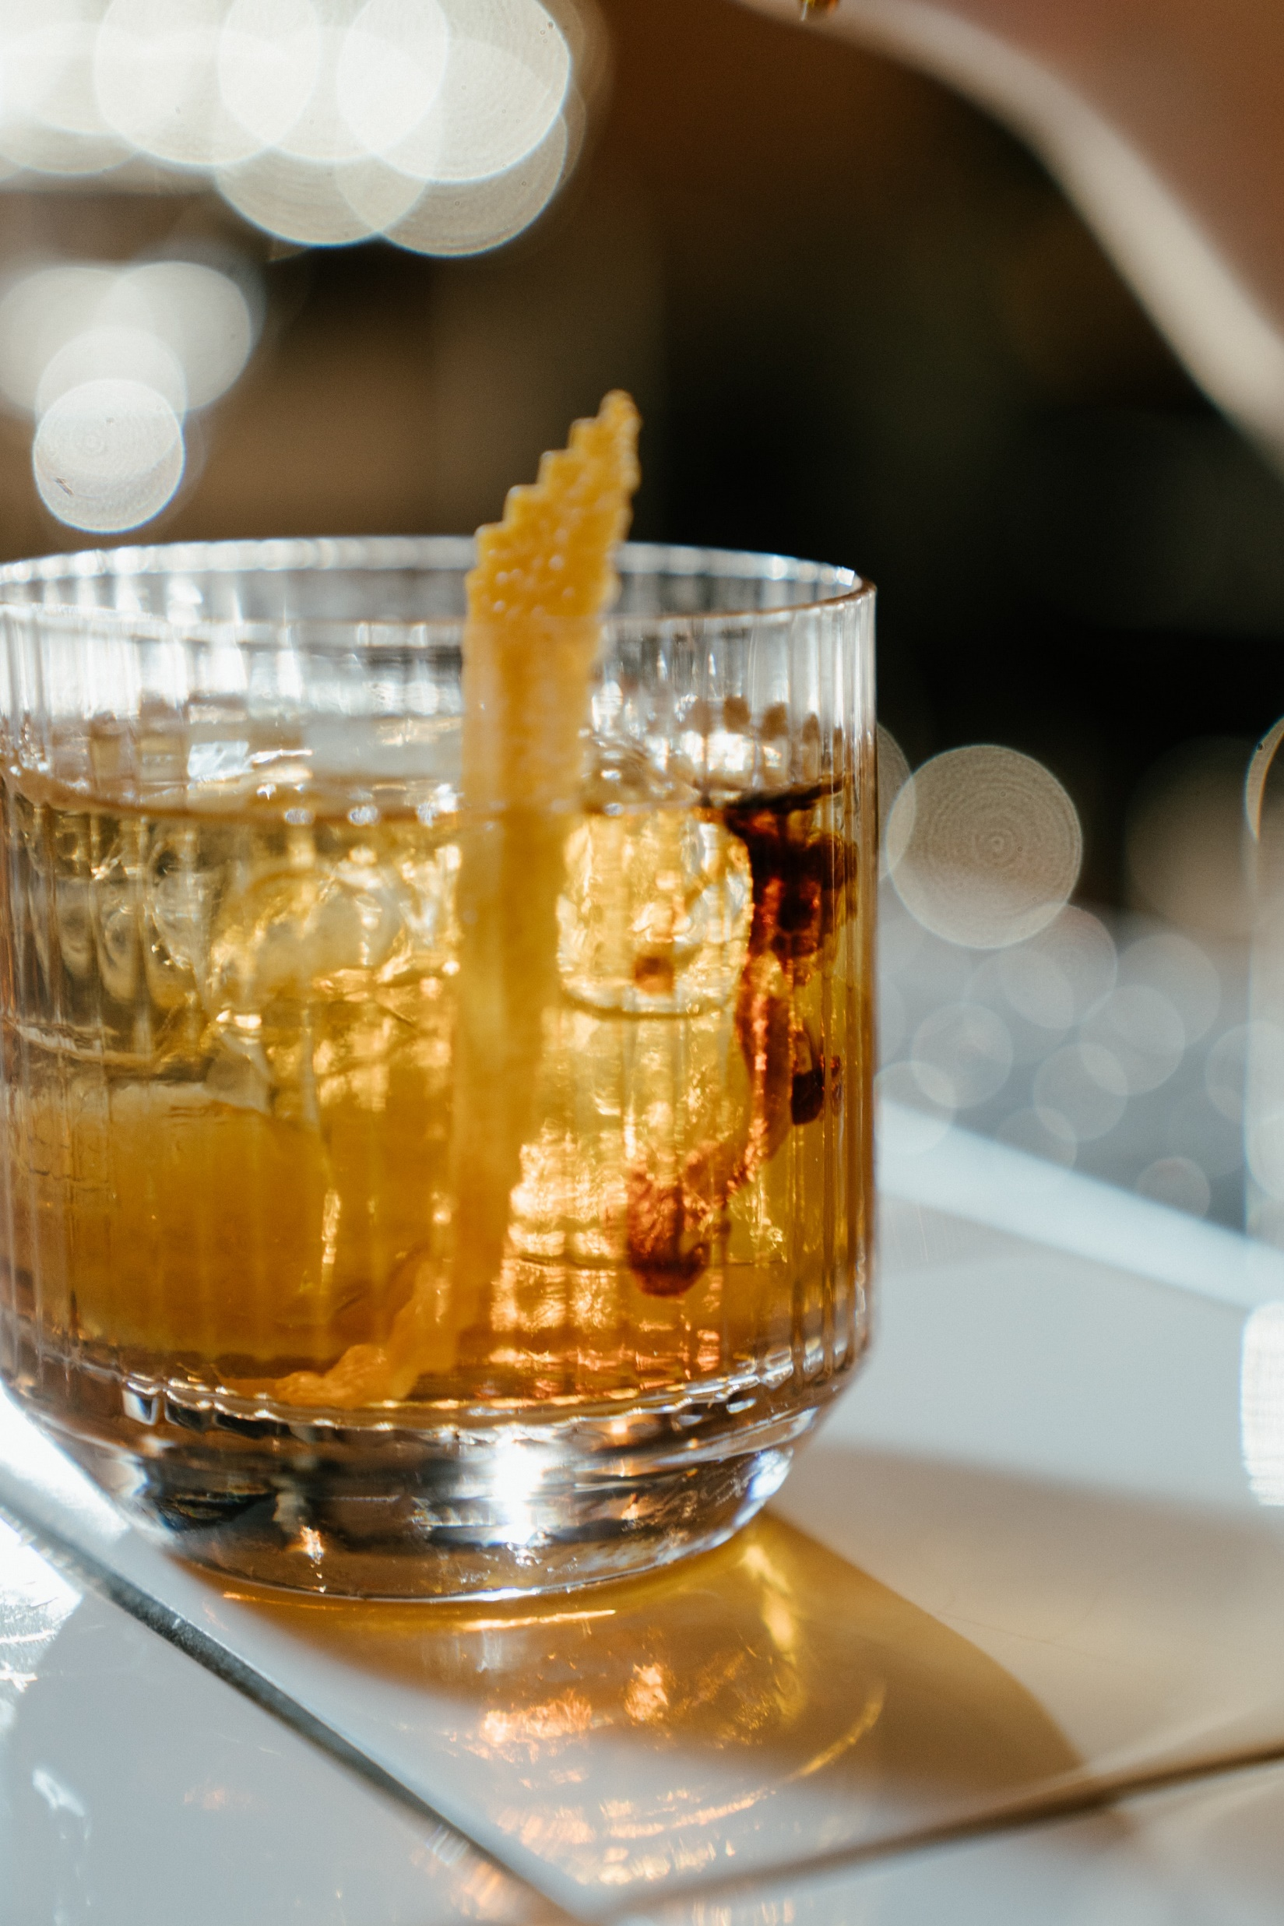
Old fashioned
2 oz. Whiskey (or any spirit)
1 sugar cube or tsp
3 dash Angostura Bitters
1 dash Orange Bitters
Splash of water or soda water
Photo by cottonbro from Pexels

Slide 9
Let’s Review
The Four Points of Balance for cocktails are?
How many families of cocktails are there? Five? Three? Six?
The name Old Fashioned comes from a style of cocktail made before Prohibition? True or False
Please raise your hand to answer the question
Photo by cottonbro from Pexels

Slide 10
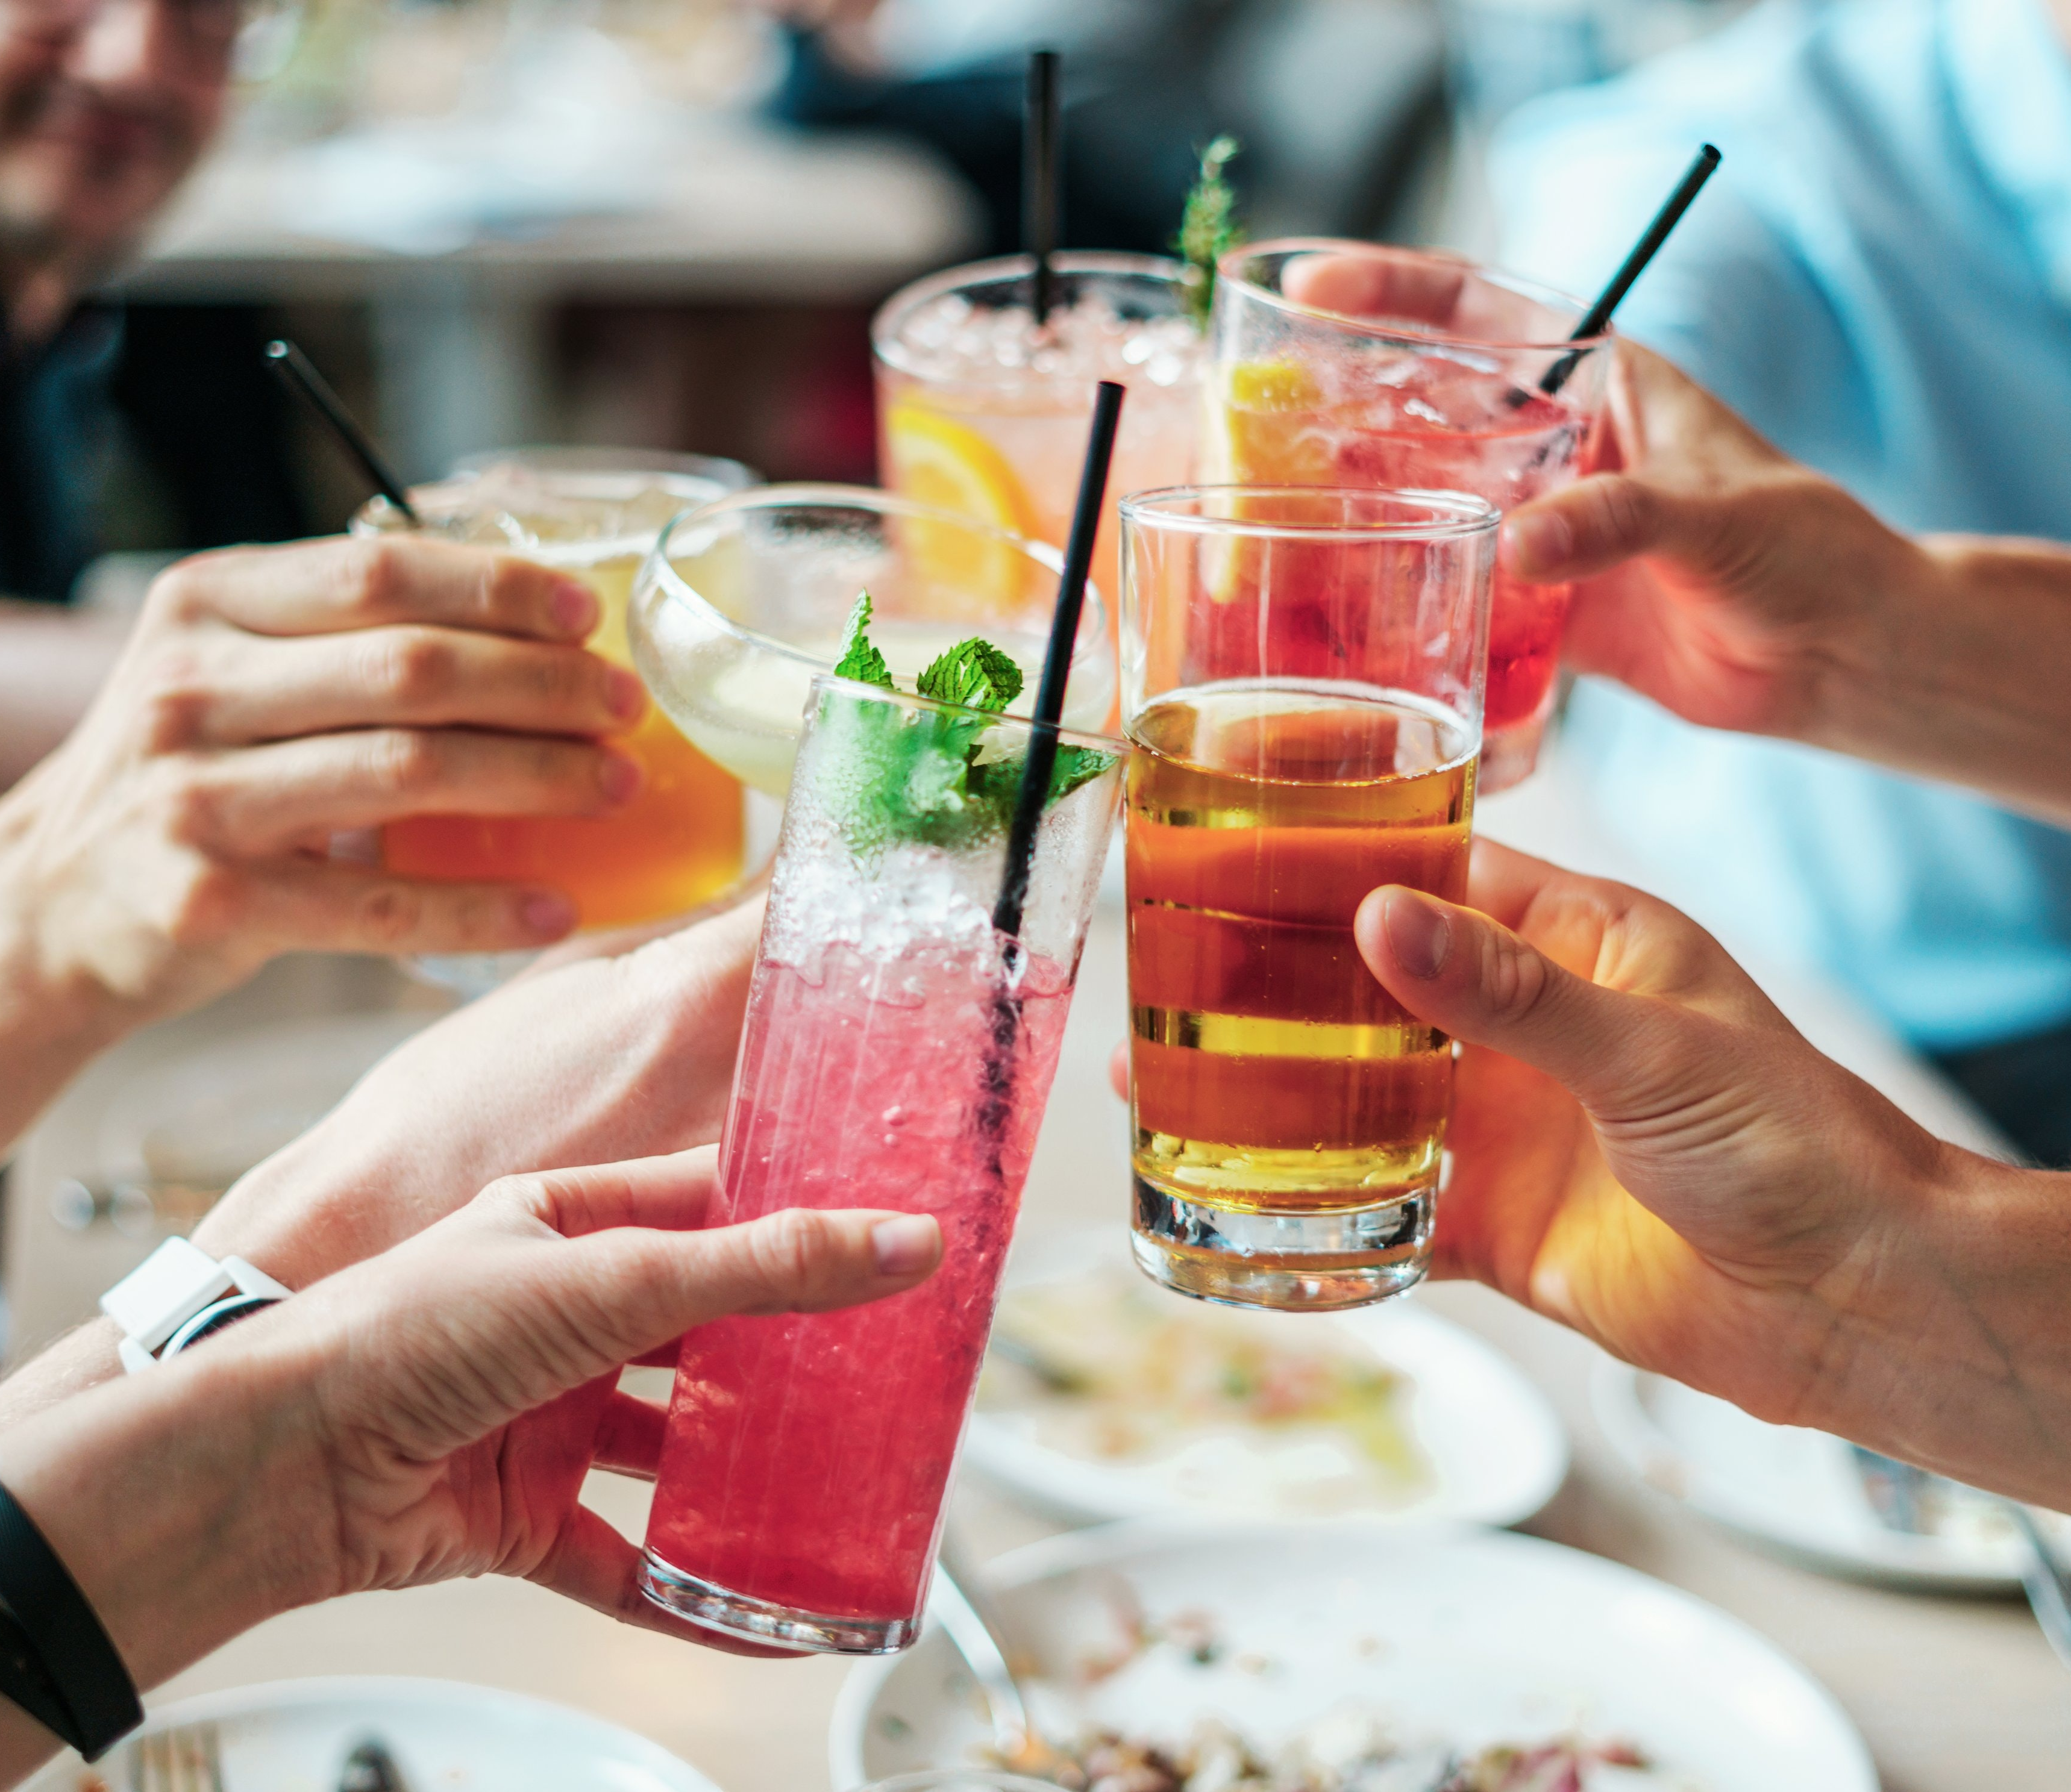
Cheers

